Slide 1



REINFORCEMENT LEARNING
done by: Joanna Tan (2214564) & Teo Wei Qi (2201902)
class: DAAA/2B/07

Slide 2
background research
DQN (Deep Q-Network) is a reinforcement learning algorithm that was primarily designed for discrete action spaces
The Pendulum environment in the OpenAI Gym is an example of a continuous action space environment
In order to use DQN, we need to discretize the action space. Discretization involves dividing the continuous action space into a finite number of bins

Slide 3
background research
tuning epsilon value (hyperparameter):
It allows us to control how much time would be spent by the agent in performing random actions in order to learn more about the environment in which it operates
when the agent uses a pure exploration policy, it might end up wasting time and resources exploring parts of the environment that are not relevant to the task at hand. This in turn would result in the agent not performing well on the assigned task

Slide 4
background research
adding epsilon_decay:
Helps the agent to achieve faster convergence as it reduces the frequency of suboptimal actions as the agent gains more confidence in its value function.
Avoid the problem of over exploration, where the agent wastes too much time & resources on exploring actions that are unlikely to be beneficial. This can also lead to under-exploration.
too high decay rate can cause under-exploration, too low decay rate can cause over-exploration

Slide 5
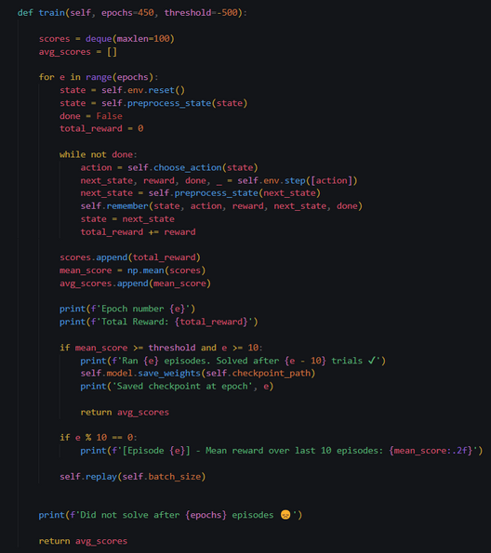
improving the training process
training without gradient tape takes hours, there was no set target network so training was unstable, could not converge even after many epochs + different hyperparameters

Slide 6
improving the training process
tf.GradiantTape() speeds up the training process from hours to minutes,
Adding a target network makes training more stable as it provides stable and consistent targets for training
analogy: a dog chasing it's own tail - it (dog) will never catch it because the target (tail) is non-stationary; this non-stationarity is exactly what the dependence between the target and the prediction cause.

Slide 7
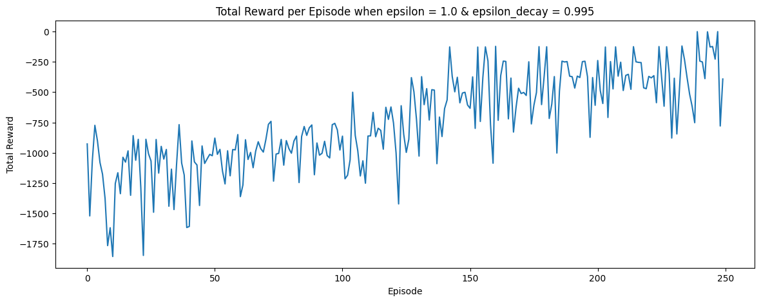
plotting total rewards
chose epsilon = 1.0, epsilon_decay = 0.995, towards the end of training, the agent does not need to purely explore actions anymore and can start to do exploitation which is why i included epsilon_decay

Slide 8
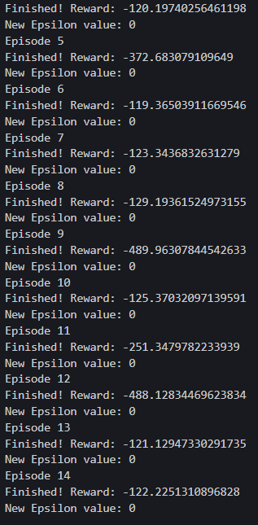
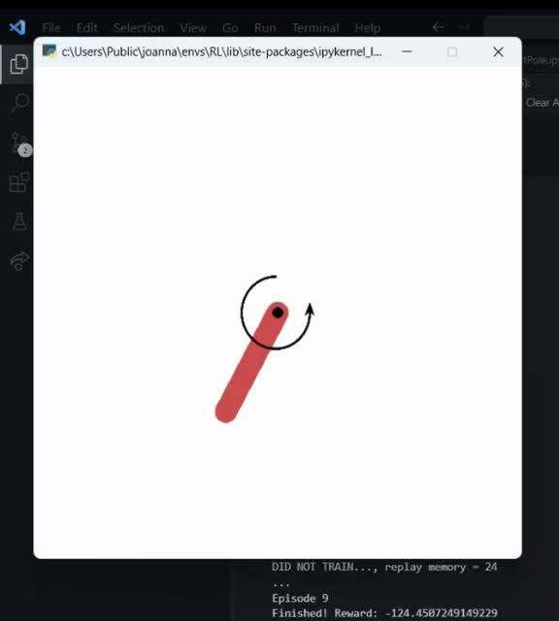

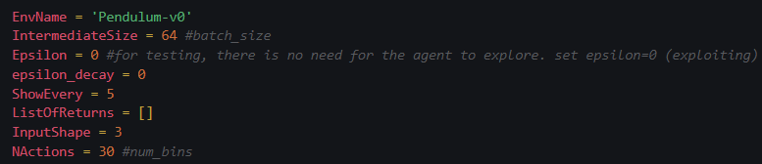
testing

